Slide 1
VUV and EUV irradiation of CH₄ + NH₃ ice mixtures
Lily Leung

Slide 2
Contents
Motivation
Methodology
Experimental setup
The spectrum of VUV (MDHL) energy source
Experimental Configurations
Results
Production of CN⁻
The relations between CN⁻ and C₂H₆
CN⁻ formation efficiency of EUV (40.8 eV) and VUV (9.27 eV)
Astrophysical Implications
Understand CN⁻ formation after winter on Charon

Slide 3
Motivation

Slide 4
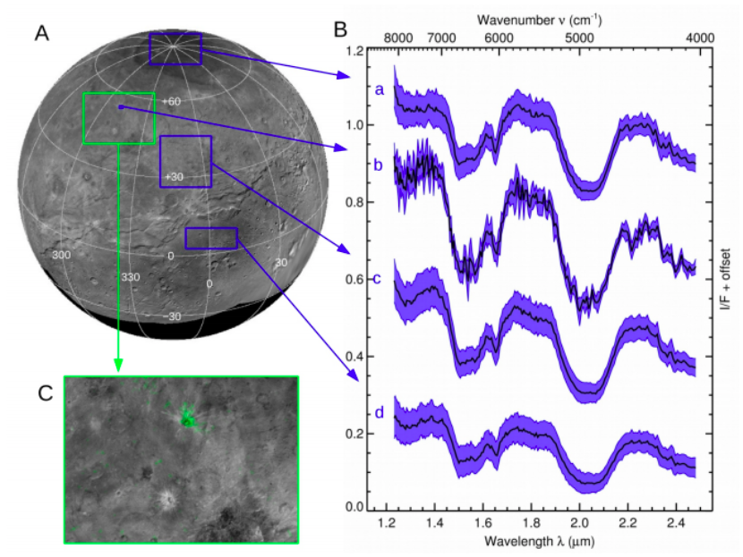
Ammonia on Organa Crater
Ammonia hydrate (2.21μm) was detected all over the surfaces, especially on Organa Crater
90º
50º
40º
10º
from Grundy et al. (2016)

Slide 5
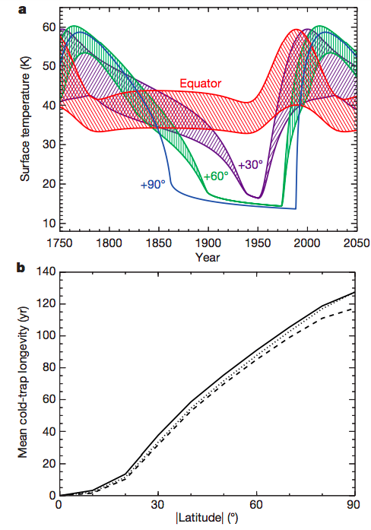
Surface temperatures
at different latitudes
Thermal model from Grundy et al. (2016) shows the pole position is below 25 K for 130 years
Methane can condense on those positions where the temperature is below 25 K.
Quoted from Grundy et al. (2016)
Notes:
The envelop is the daily temperature variation of Charon (dinual) which varies based on direct sunlight exposure
The plot underneath is based on the top model, calculated by length of time different lattitudes are under 25 K
From this graph, we may observe that there are about 130 years of winter time at pole positions.

Slide 6
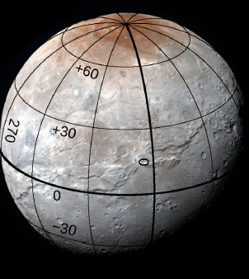
What astrophysical environments are we demonstrating?
Charon in Pluto system
VUV and EUV irradiation
NH₃
+
CN⁻
CH₄
Quoted from Grundy et al. (2017)
Notes:
Introduce Charon & Pluto
where when how and who

Slide 7
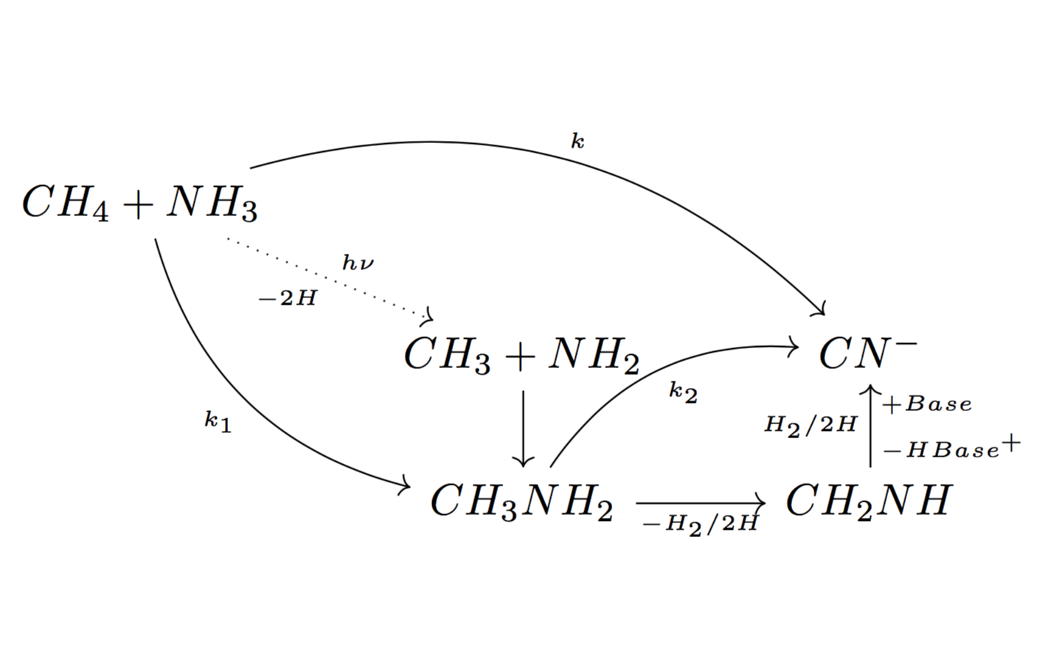
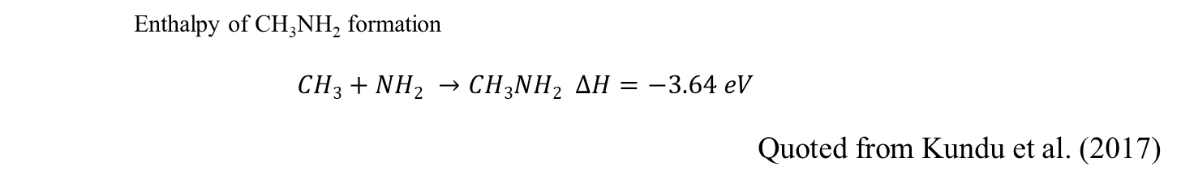
Production mechanism of CN⁻
Enthalpy of CH₃NH₂ formation
$$CH3+NH2 →CH3NH2 ∆H=−3.64 eV$$
Quoted from Kundu et al. (2017)
Quoted from Kim and Kaiser (2011)

Slide 8
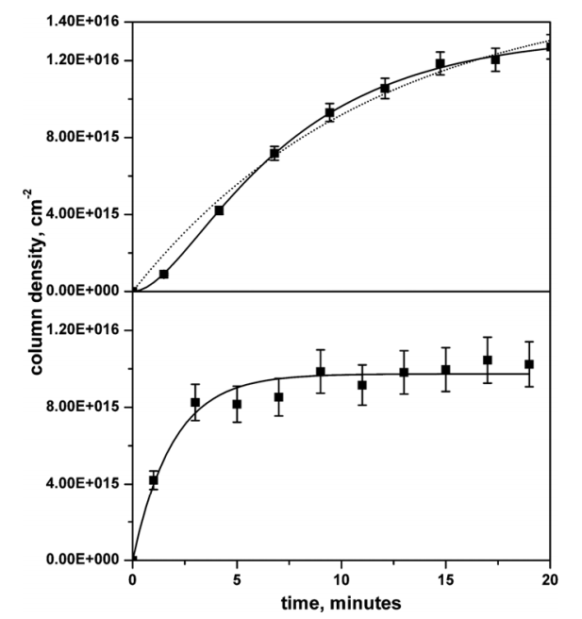

Production of CN⁻
2 steps/1 step?
2 steps rate equation:
$\left[{CN}^{−}\right]=\left(1+\frac{{k_{1}e}^{−k_{2}t}}{k_{2}−k_{1}}−\frac{{k_{2}e}^{−k_{1}t}}{k_{2}−k_{1}}\right){[A]}_{o}$
1 step rate equation:
$\left[{CN}^{−}\right]=\left(1−e^{−kt}\right){[A]}_{o}$
Quoted from Kim and Kaiser (2011)
Notes:
With the column density, this is the cyanide ion formation in 5KeV electron irradiation done by Kim & Kaiser. The upper panel is CH4+NH3 (3:1) irradiated by 0.1 uA electron gun. It is better fitted by the 2 step rate equation (solid line). After they increased the electron flux to 10 times, and changing CH4 to CnH(2n+2), n=1-6, they obtained a one step pathway.
The deviation of these two equations are presented in my thesis

Slide 9
Production mechanism of CN⁻
Different results from 2 e⁻ irradiating experiments
5 keV e⁻ by Kim and Kaiser (2011):
The intermediate CH₃NH₂ was detected by TPD
1- 90 eV e⁻ experiment by Kundu et al.(2017)
The intermediate CH₃NH₂ cannot be detected by TPD

Slide 10
Experimental Protocol:
1. To compare with previous studies
Kim and Kaiser (CH₄:NH₃ 3:1) (5 keV e⁻)
Kundy et al. (CH₄:NH₃ 3:2) (1-90 eV e⁻)
We perform (CH₄:NH₃ 3:2)
photon sources: VUV (9.27 eV) and EUV (40.8 eV)
2. To simulate the surface of Charon
Different relative proportion of
CH₄:NH₃ 1:5, 1:10, 1:20
Notes:
As a summary, to compare with previous studies, we repeat the experiments with photon sources with relative proportion of CH4:NH3 =3:2

Slide 11
Methodology

Slide 12
Experimental Configurations
Energetic Source | Constituent | Column Density (x10 ¹⁵ molecules cm⁻²)
 |  | 3:2 | 1:5 | 1:10 | 1:20
VUV (MDHL) | CH₄ | 900 | 120 | 60 | 30
 | NH₃ | 600 | 600 | 600 | 600
EUV (30.4 nm) | CH₄ | 900 | 120 | -- | --
 | NH₃ | 600 | 600 | -- | --
Different initial amount of CH₄ correspond to different ratio of CH₄:NH₃ ice mixtures
Notes:
NH3 conlumn density is fixed

Slide 13
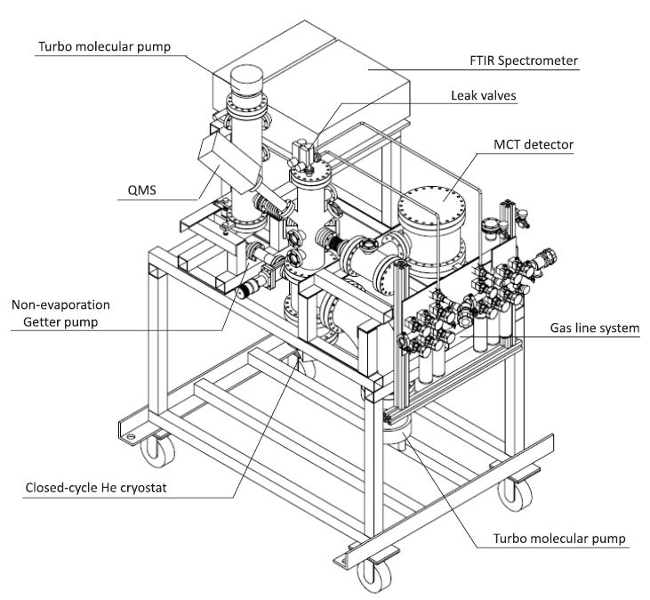
Experimental setup
IR path
VUV/EUV path
Quoted from Chen et al. (2014)
Notes:
3 systems: main chamber, detection system and gas-mixing system
IR path and VUV path

Slide 14
Experimental Procedure
Infra-red
KBr substrate is pre-cooled to 15 K (1 x 10 ⁻¹⁰ torr) from 300 K ( 8 x 10 ⁻¹⁰ torr)
QMS
Deposit the ice mixtures through leak valve, with different partial pressures of CH₄ and NH₃
EUV/VUV
Irradiate the samples by EUV/VUV
KBr substrate
Warm-up with 1 K/min

Slide 15
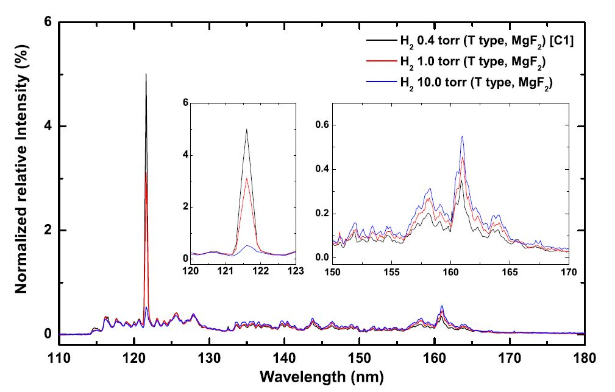
The spectrum of VUV (MDHL) energy source
H₂ 0.4 torr was adopted
19.1% is Ly-α
average photon energy is 9.27 eV
EUV is 40.8 eV (30.4nm) provided by NSRRC
Quoted from Chen et al. (2014)

Slide 16
Results

Slide 17
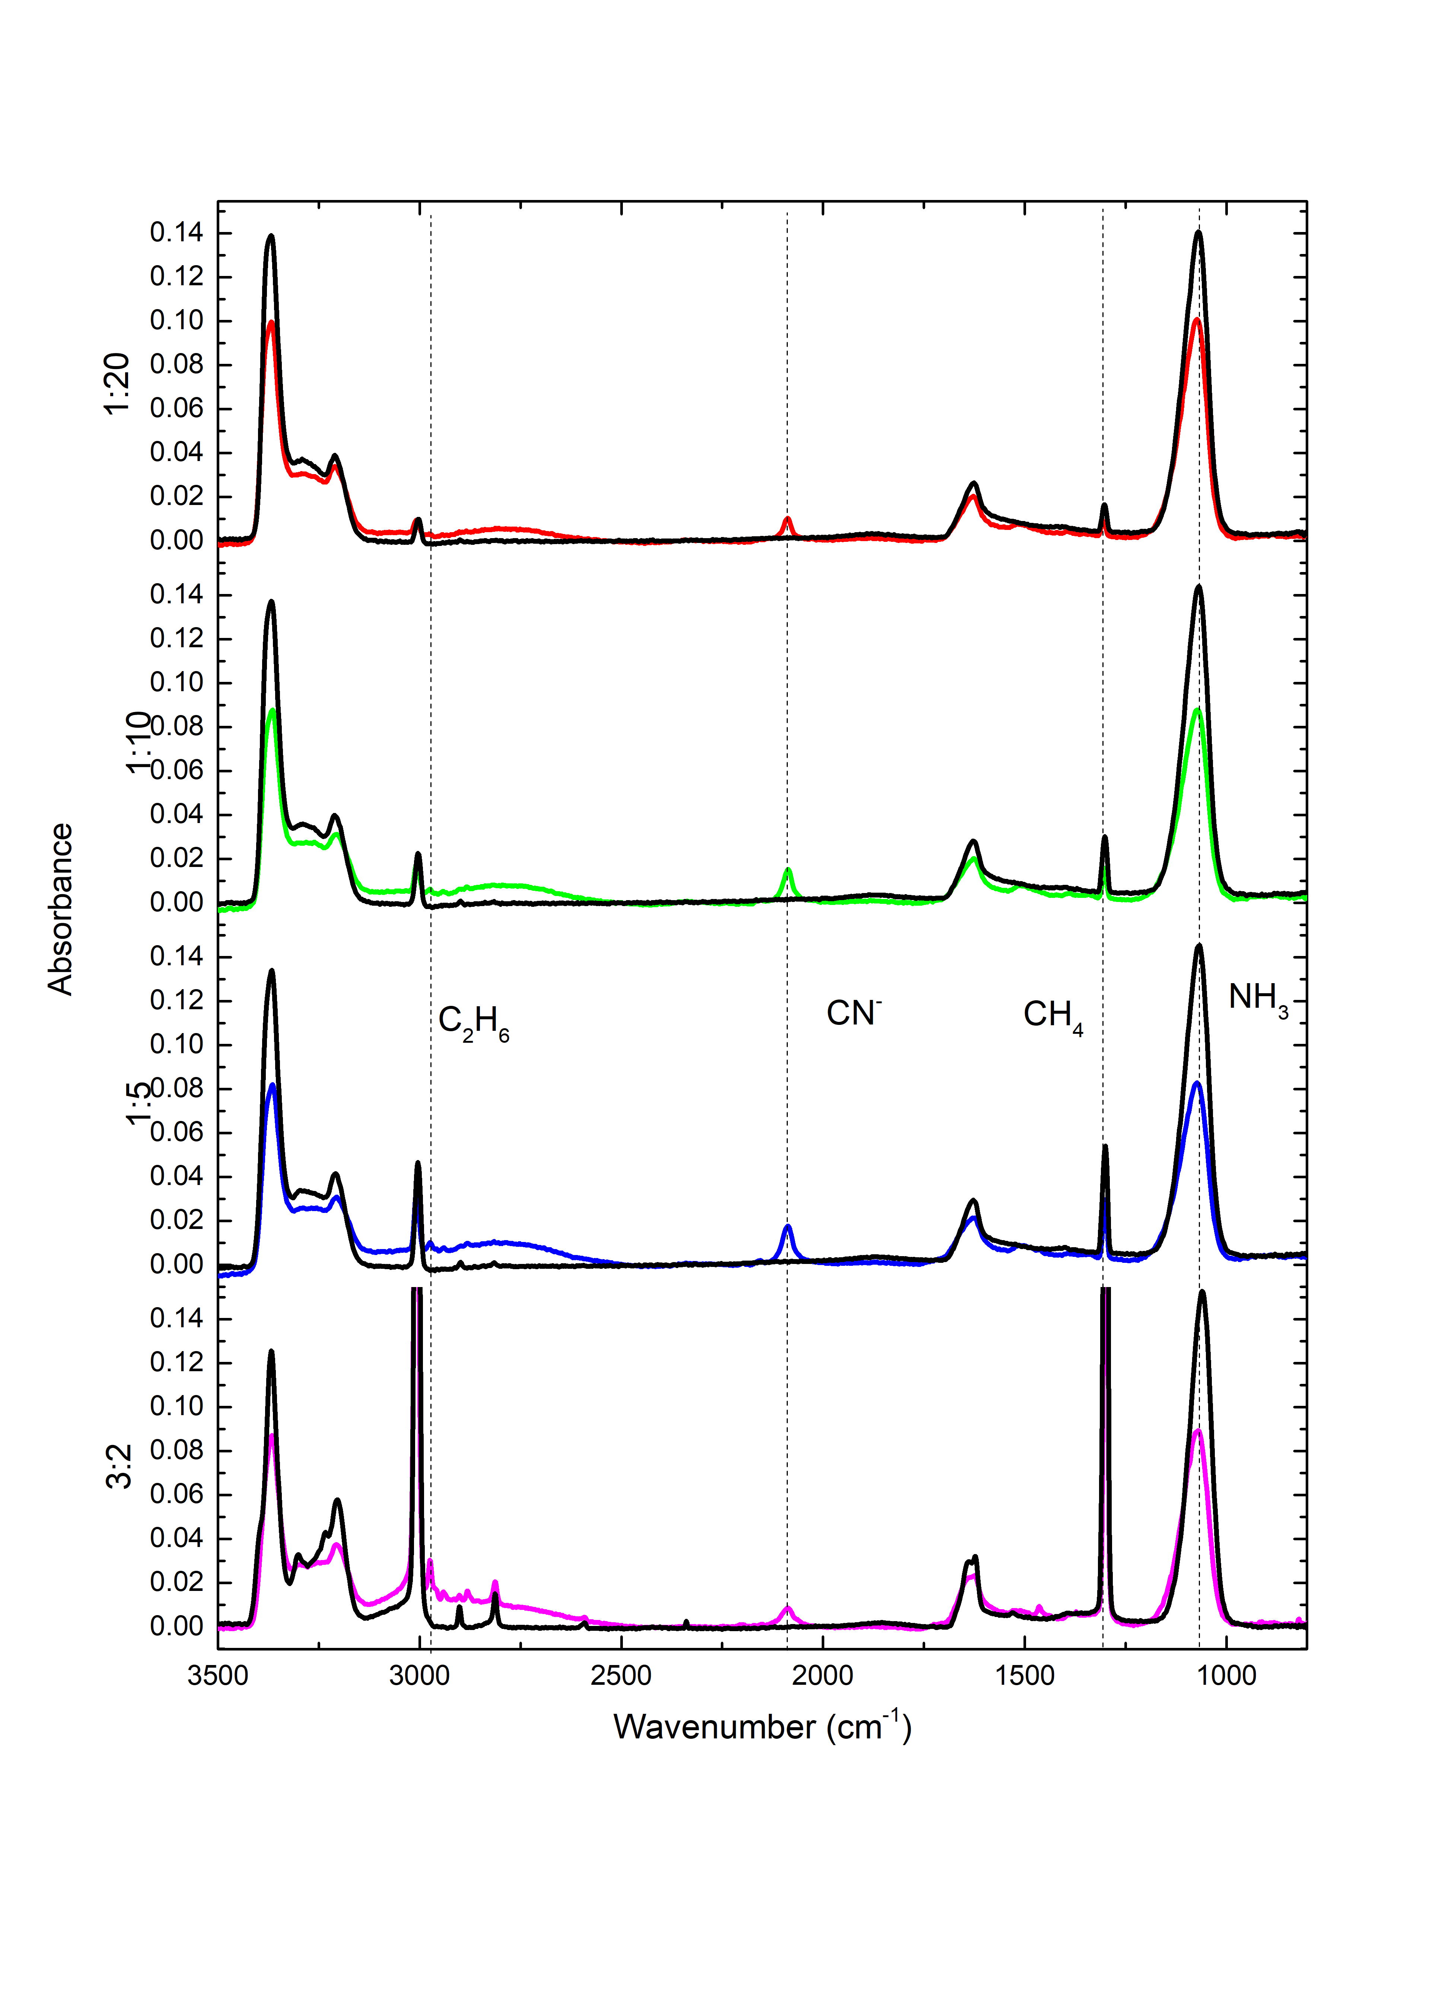
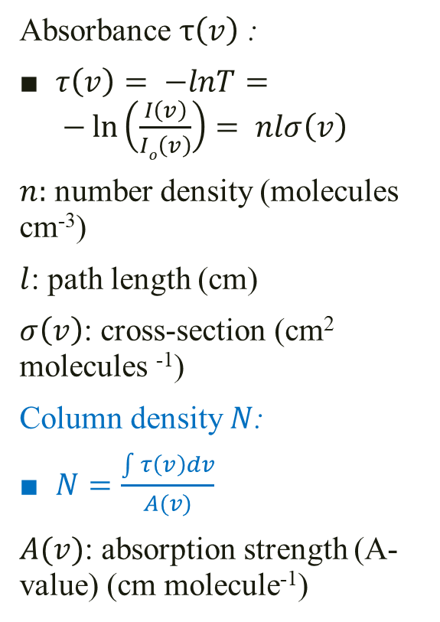
Beer’s Law
Absorbance $τ\left(v\right)$ :
$τ\left(v\right)= −lnT= −\ln\left(\frac{I\left(v\right)}{Io\left(v\right)}\right)= nlσ\left(v\right)$
$n:$ number density (molecules cm⁻³)
$l$: path length (cm)
$σ\left(v\right)$: cross-section (cm² molecules ⁻¹)
Column density $N$:
$N=\frac{\int{τ\left(v\right)dv}}{A(v)}$
$A(v)$: absorption strength (A-value) (cm molecule⁻¹)
Infra-red spectra before (black lines) and after (coloured lines) VUV irradiation where CN⁻, C₂H₆ and C₃H₈ are formed after VUV irradiation.
Notes:
$τ$is optical depth defined by log (T/To)

Slide 18
1. Production of CN⁻
Notes:
By VUV irradiations, all of our results belongs to a one step mechanism because all of our fitting k2>1
This is similar to Kaiser’s one step mechanism.

Slide 19
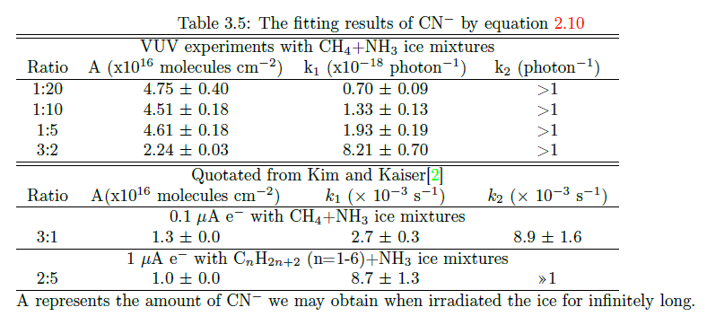

1. Production of CN⁻
$\left[{CN}^{−}\right]=\left(1+\frac{{k_{1}e}^{−k_{2}t}}{k_{2}−k_{1}}−\frac{{k_{2}e}^{−k_{1}t}}{k_{2}−k_{1}}\right){[A]}_{o}$
Notes:
By VUV irradiations, all of our results belongs to a one step mechanism because all of our fitting has a k2>1

Slide 20
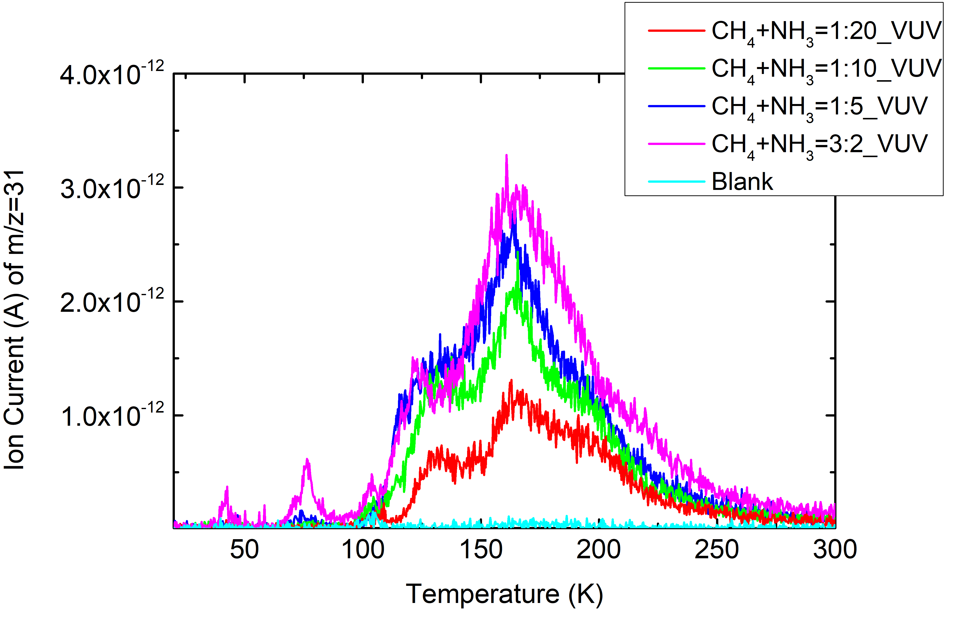
1. Production of CN⁻
Methylamine (CH₃NH₂) with m/z=31 is detected by QMS
CN⁻ is formed via a 2 step mechanism.
Notes:
The detection of methylamine during our warmup phase, confirms that CN- is produced through this mechanism, which also suggests that the non-detection of Kundu’s experiments should be due to the ice thickness, they have only a few monolayers
CH4: 6-7 ML NH3: 4-5 ML. Next, we will now look at the second result: relations of photo-products variating the relative proportions of ice mixtures.

Slide 21
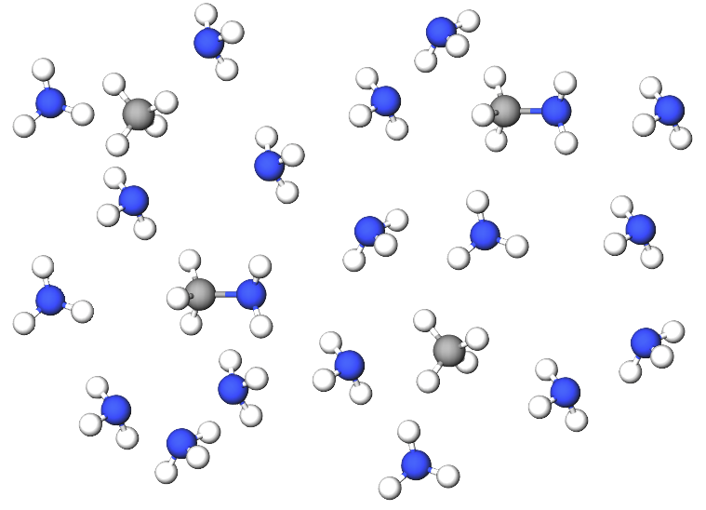
2. The scenario for NH₃ dominating ice mixtures
CH₄
CH₃NH₂
NH₃
Once CH₄ becomes CH₃ radical, CH₃NH₂ can be easily formed and hence become CN⁻.
A diagram of CH₄:NH₃ = 1:5

Slide 22
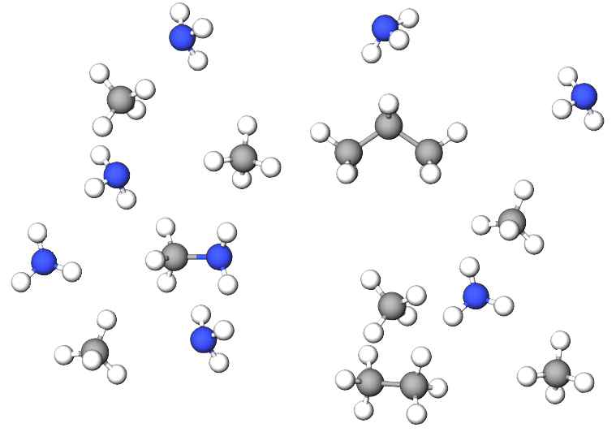
2. The scenario for CH₄ dominating ice mixtures
CH₄
C₃H₈
NH₃
CH₃NH₂ (formed by CH₃ + NH₂) has a competing relationship with C₂H₆ (formed by 2 CH₃) and C₃H₈ (formed by CH₂ + C₂H₆ or C₂H₄ + CH₄)
C₂H₆ can form easier than NH₃ dominating case
CH₃NH₂
C₂H₆
A diagram of CH₄+NH₃ = 3:2

Slide 23
2. The relations between CN⁻ (NH₃ dominant) and C₂H₆ (CH₄ dominant)
CH₄:NH₃ | C₂H₆ (ML) | CN⁻ (ML) | Ratio of CN⁻to C₂H₆
3:2 (CH₄ dominant) | 19.1 | 23 | 1.2
1:5 (NH₃ dominant) | 4.3 | 49 | 11.3
Concentration of CN⁻ is not proportional to initial amount of CH₄ when CH₄ is in excess.

Slide 24
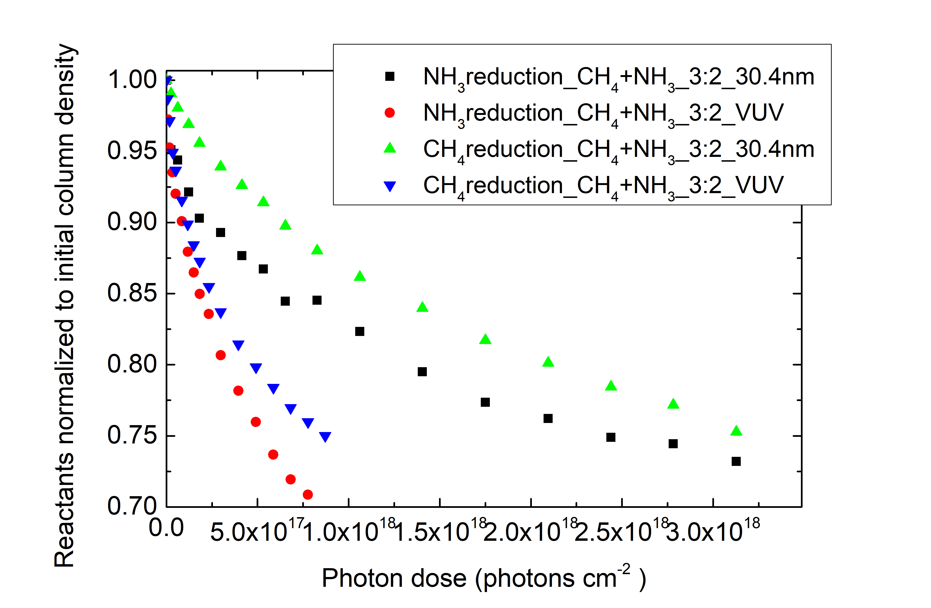
3. Rate constant of reactants by EUV (40.1 eV) and VUV (9.27 eV)
Fitting with y = Ae^{-kx} + C (first order decay)
Ratio of CH₄+NH₃ | 3:2 |  | 1:5
k (photons⁻¹cm²) | CH₄ (x 10⁻¹⁸) | NH₃ (x10⁻¹⁸) | CH₄ (x 10⁻¹⁸) | NH₃ (x10⁻¹⁸)
VUV (MDHL) | 3.70±0.18 | 2.89±0.10 | 2.70±0.07 | 1.17±0.12
EUV (30.4nm) | 0.61±0.03 | 0.91±0.11 | 0.49±0.02 | 0.56±0.06
Destruction cross-section ratio | 6.06±0.07 | 3.18±0.12 | 5.52±0.07 | 2.07±0.13

Slide 25
3. CN⁻ formation efficiency of EUV (40.1 eV) and VUV (9.27 eV)
k (photon ⁻¹cm²) | CH₄ : NH₃ 3:2 (x 10⁻¹⁸) | CH₄ : NH₃ 1:5 (x10⁻¹⁸)
VUV (MDHL) | 8.21±0.70 | 1.93±0.19
EUV (30.4nm) | 1.92±1.99 | 0.63±0.37
CN⁻ production ratio | 4.28 | 3.06
Destruction cross-section ratio (CH₄) | 6.06±0.07 | 5.52±0.07
Destruction cross-section ratio (NH₃) | 3.18±0.12 | 2.07±0.13

Slide 26
3. Energy needed for forming radicals by EUV (40.1 eV) and VUV (9.27 eV)
Radicals species | CH₄ | NH₃
- 1 H | 4.55 eV | 4.67 eV
-2 H | 4.78 eV | 4.38 eV
-3 H | 9.19 eV | 7.63 eV
Quoted from Kundu et al. (2017)

Slide 27
Astrophysical Implications

Slide 28
Estimate the column density of CN⁻ formed after winter on Charon (from result 2)
Ly-α flux: 1.9 x 10⁹ eV cm⁻² s⁻¹ (Grundy et al. 2016)
→photon dose after 1 Pluto winter 7.64 x 10 ¹⁷ photons cm⁻²
CH₄ after winter ~173 ML
Assume the column density of NH₃ is 600 ML
CH₄:NH₃ | CH₄ (ML) | CN⁻ (ML)
1:5 | 120 | 36.6
1:10 | 60 | 29.5
1:20 | 30 | 18.9
3:2 | 900 | 22.5

Slide 29
Ly-α is the main photon source to produce CN⁻ on Charon (from result 3)
VUV(19.1% of which is Ly- α) will produce CN⁻ 3.06 - 4.28 times more efficient than EUV
It is expected that Ly- α will produce CN⁻ more efficient than EUV
Ly- α flux is 1 order of magnitude more intense than EUV irradiations at 39.1 A.U. (Grundy et al. 2016)
Ly-α flux: 1.9 x 10⁹ eV cm⁻² s⁻¹
EUV flux: 8.7 x 10⁷ eV cm⁻² s⁻¹

Slide 30
Conclusion
1. Detection of methylamine implies that CN⁻ is formed via a 2 step mechanism.
2. Formation of CN⁻ is not proportional to the initial column density of CH₄ when CH₄ is in excess.
This implies that we have to experimentally estimate the column density of CN⁻ after Charon winter for further investigations.
3. The reduced destruction cross-section of EUV (30.4nm) irradiation is the main factor of reducing the formation rate of CN⁻.
This implies that Ly-α (VUV) is the main photon source to produce CN⁻ on Charon.

Slide 31
Q & A

Slide 32
Production yield and production rates
The yields should be correlated with initial limiting substances
Fitting rates are the same

